Slide 1
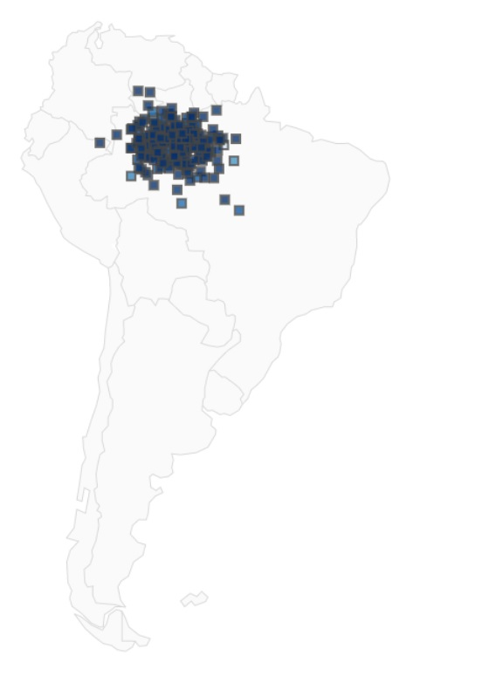
Amazon Rain Forest Deforestation
Upload Images
Latitude ___________
Longitude ____________
Filter Options:
Descriptive Stats
% of total files
% of coverage
Location of cluster
Weather Type Tag
Forest Coverage
New Data
Existing Data

